Slide 1

Elevating You Leadership Through
CONSCIOUS ACCOUNTABILITY
David C. Tate, PhD
Sinovation Fellows Program
February 14, 2023

Slide 2

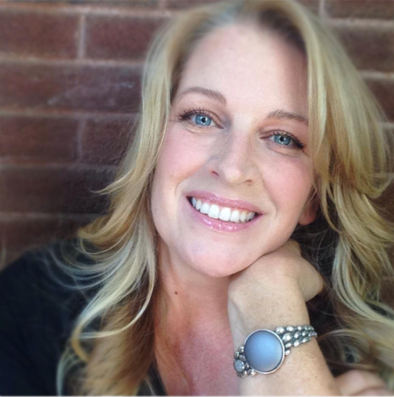
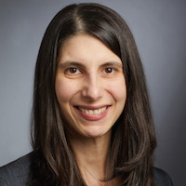
Dr. Marianne
Pantalon
Dr. Daryn
David

Slide 3
AGENDA
1
2
3
4
Why
it matters
What
is it
How
to create it
Explore
your practice
of it

Slide 4
“Culture eats strategy for breakfast”
-Peter Drucker

Slide 5

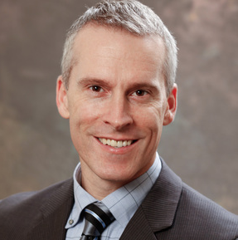



Hello
Clinical Psychologist
Leadership Coach
Teacher
David C. Tate, PhD
Author
david.tate@yale.edu
(203) 627-6618

Slide 6
WHY
does accountability matter?

Slide 7
Trust
Life or death
Reputation
Learning
Efficiency
(time & costs)
Integrity
Results

Slide 8
WHAT
is conscious accountability?

Slide 9
ACCOUNTABLE

Slide 10

WHAT Does It Mean To Be Accountable?
Required to explain actions or decisions to someone
Subject to giving an account, answerable
Required to be responsible for something

Slide 11
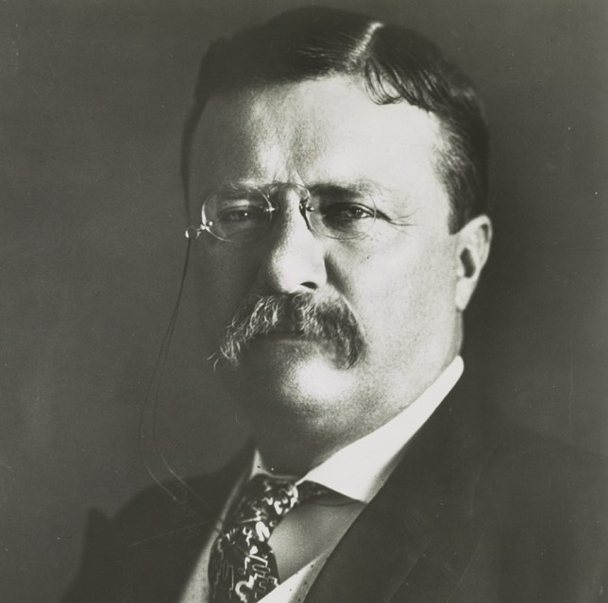
“If you could kick the person in the pants responsible for most of your trouble, you wouldn’t sit for a month.”
- Theodore Roosevelt

Slide 12


HOW IS CONSCIOUS ACCOUNTABILITY DIFFERENT?
ACCOUNTABILITY 1.O
CONSCIOUS ACCOUNTABILITY
Results
Results & Relationships
Sole Responsibility
Shared Responsibility
Backward Facing
Blame
Forward Facing
Learning
Transactional
Transformational

Slide 13






A BROADER FRAMING OF ACCOUNTABILITY
Self &
Others
Essential Skill
Mindset & Behaviors
Values & Norms
Journey vs
Destination

Slide 14
CONSCIOUS ACCOUNTABILITY means • expanding awareness • to create deliberate intentions, • take informed actions, and • be responsible for your impact.

Slide 15

In your work with others, what does it mean to be (consciously) accountable in terms of…
BRAINSTORMING EXERICSE
Thoughts and mindsets? (Group 1)
Actions and behaviors? (Group 2)
Management and leadership? (Group 3)
Teams and organizations? (Group 4)

Slide 16




KEY MINDSETS
Interdependence
Growth Mindset
Total Responsibility

Slide 17



KEY BEHAVIORS
Planning
Communication
Integrity

Slide 18



ACCOUNTABLE LEADERS
Set the Example
Articulate
Vision & Expectations
Coach/
Develop Others

Slide 19



ACCOUNTABLE TEAMS / ORGANIZATIONS
Engaged
Shared Values
Open/Transparent

Slide 20
HOW
can we promote
conscious accountability?

Slide 21
7
ACCOUNTABLE TEAMS / ORGANIZATIONS
PRACTICES OF CONSCIOUS ACCOUNTABILITY
C
O
N
N
E
C
T
CREATING
CLARITY
OPENING UP
ENGAGEMENT
NAILING IT
NOTICING
EXCHANGING
FEEDBACK
CLAIMING IT
TRYING
AGAIN
Establishing clear goals and shared expectations
Building commitment + psychological safety
Doing what you say you will do
Checking in with self and others
Promoting awareness and learning
Owning the results
Iterating for continuous improvement

Slide 22
7
ACCOUNTABLE TEAMS / ORGANIZATIONS
PRACTICES OF CONSCIOUS ACCOUNTABILITY
C
O
N
N
E
C
T
CREATING
CLARITY
OPENING UP
ENGAGEMENT
NAILING IT
NOTICING
EXCHANGING
FEEDBACK
CLAIMING IT
TRYING
AGAIN
Establishing clear goals and shared expectations
Building commitment + psychological safety
Doing what you say you will do
Checking in with self and others
Promoting awareness and learning
Owning the results
Iterating for continuous improvement

Slide 23
7
ACCOUNTABLE TEAMS / ORGANIZATIONS
PRACTICES OF CONSCIOUS ACCOUNTABILITY
C
O
N
N
E
C
T
CREATING
CLARITY
OPENING UP
ENGAGEMENT
NAILING IT
NOTICING
EXCHANGING
FEEDBACK
CLAIMING IT
TRYING
AGAIN
Establishing clear goals and shared expectations
Building commitment + psychological safety
Doing what you say you will do
Checking in with self and others
Promoting awareness and learning
Owning the results
Iterating for continuous improvement

Slide 24


PSYCHOLOGICAL SAFETY: What is it?
DEFINITION: feeling able to show and employ one's self without fear of negative
consequences of self-image, status, or career
IDEA: only when people feel they can fully voice their opinions and perspectives can the group’s full potential be achieved
Notes:
One key idea that I think generates strong ROI is the idea of psychological safety.
Definition: Psychological Safety is feeling able to show and employ one's self without fear of negative consequences of self-image, status, or career. ​
Idea is that unless people feel they can fully voice their opinions and perspectives, you cannot achieve the potential that a diverse group holds.

Slide 25
7
ACCOUNTABLE TEAMS / ORGANIZATIONS
PRACTICES OF CONSCIOUS ACCOUNTABILITY
C
O
N
N
E
C
T
CREATING
CLARITY
OPENING UP
ENGAGEMENT
NAILING IT
NOTICING
EXCHANGING
FEEDBACK
CLAIMING IT
TRYING
AGAIN
Establishing clear goals and shared expectations
Building commitment + psychological safety
Doing what you say you will do
Checking in with self and others
Promoting awareness and learning
Owning the results
Iterating for continuous improvement

Slide 26
7
ACCOUNTABLE TEAMS / ORGANIZATIONS
PRACTICES OF CONSCIOUS ACCOUNTABILITY
C
O
N
N
E
C
T
CREATING
CLARITY
OPENING UP
ENGAGEMENT
NAILING IT
NOTICING
EXCHANGING
FEEDBACK
CLAIMING IT
TRYING
AGAIN
Establishing clear goals and shared expectations
Building commitment + psychological safety
Doing what you say you will do
Checking in with self and others
Promoting awareness and learning
Owning the results
Iterating for continuous improvement

Slide 27
7
ACCOUNTABLE TEAMS / ORGANIZATIONS
PRACTICES OF CONSCIOUS ACCOUNTABILITY
C
O
N
N
E
C
T
CREATING
CLARITY
OPENING UP
ENGAGEMENT
NAILING IT
NOTICING
EXCHANGING
FEEDBACK
CLAIMING IT
TRYING
AGAIN
Establishing clear goals and shared expectations
Building commitment + psychological safety
Doing what you say you will do
Checking in with self and others
Promoting awareness and learning
Owning the results
Iterating for continuous improvement

Slide 28
7
ACCOUNTABLE TEAMS / ORGANIZATIONS
PRACTICES OF CONSCIOUS ACCOUNTABILITY
C
O
N
N
E
C
T
CREATING
CLARITY
OPENING UP
ENGAGEMENT
NAILING IT
NOTICING
EXCHANGING
FEEDBACK
CLAIMING IT
TRYING
AGAIN
Establishing clear goals and shared expectations
Building commitment + psychological safety
Doing what you say you will do
Checking in with self and others
Promoting awareness and learning
Owning the results
Iterating for continuous improvement

Slide 29
7
ACCOUNTABLE TEAMS / ORGANIZATIONS
PRACTICES OF CONSCIOUS ACCOUNTABILITY
C
O
N
N
E
C
T
CREATING
CLARITY
OPENING UP
ENGAGEMENT
NAILING IT
NOTICING
EXCHANGING
FEEDBACK
CLAIMING IT
TRYING
AGAIN
Establishing clear goals and shared expectations
Building commitment + psychological safety
Doing what you say you will do
Checking in with self and others
Promoting awareness and learning
Owning the results
Iterating for continuous improvement

Slide 30
BREAK

Slide 31
EXPLORING
Your practice of accountability

Slide 32


Think of a time when you DID
hold yourself accountable?
Think of a time when you
DID
hold someone else accountable?
What were your mindsets or behaviors?
What were the results?
What were your mindsets or behaviors?
What were the results?
Compare these examples. What was different?
Think of a time when you DID NOT
hold yourself accountable?
Think of a time when you
DID NOT
hold someone else accountable?
What were your mindsets or behaviors?
What were the results?
What were your mindsets or behaviors?
What were the results?

Slide 33
7
ACCOUNTABLE TEAMS / ORGANIZATIONS
PRACTICES OF CONSCIOUS ACCOUNTABILITY
C
O
N
N
E
C
T
CREATING
CLARITY
OPENING UP
ENGAGEMENT
NAILING IT
NOTICING
EXCHANGING
FEEDBACK
CLAIMING IT
TRYING
AGAIN
Establishing clear goals and shared expectations
Building commitment + psychological safety
Doing what you say you will do
Checking in with self and others
Promoting awareness and learning
Owning the results
Iterating for continuous improvement

Slide 34
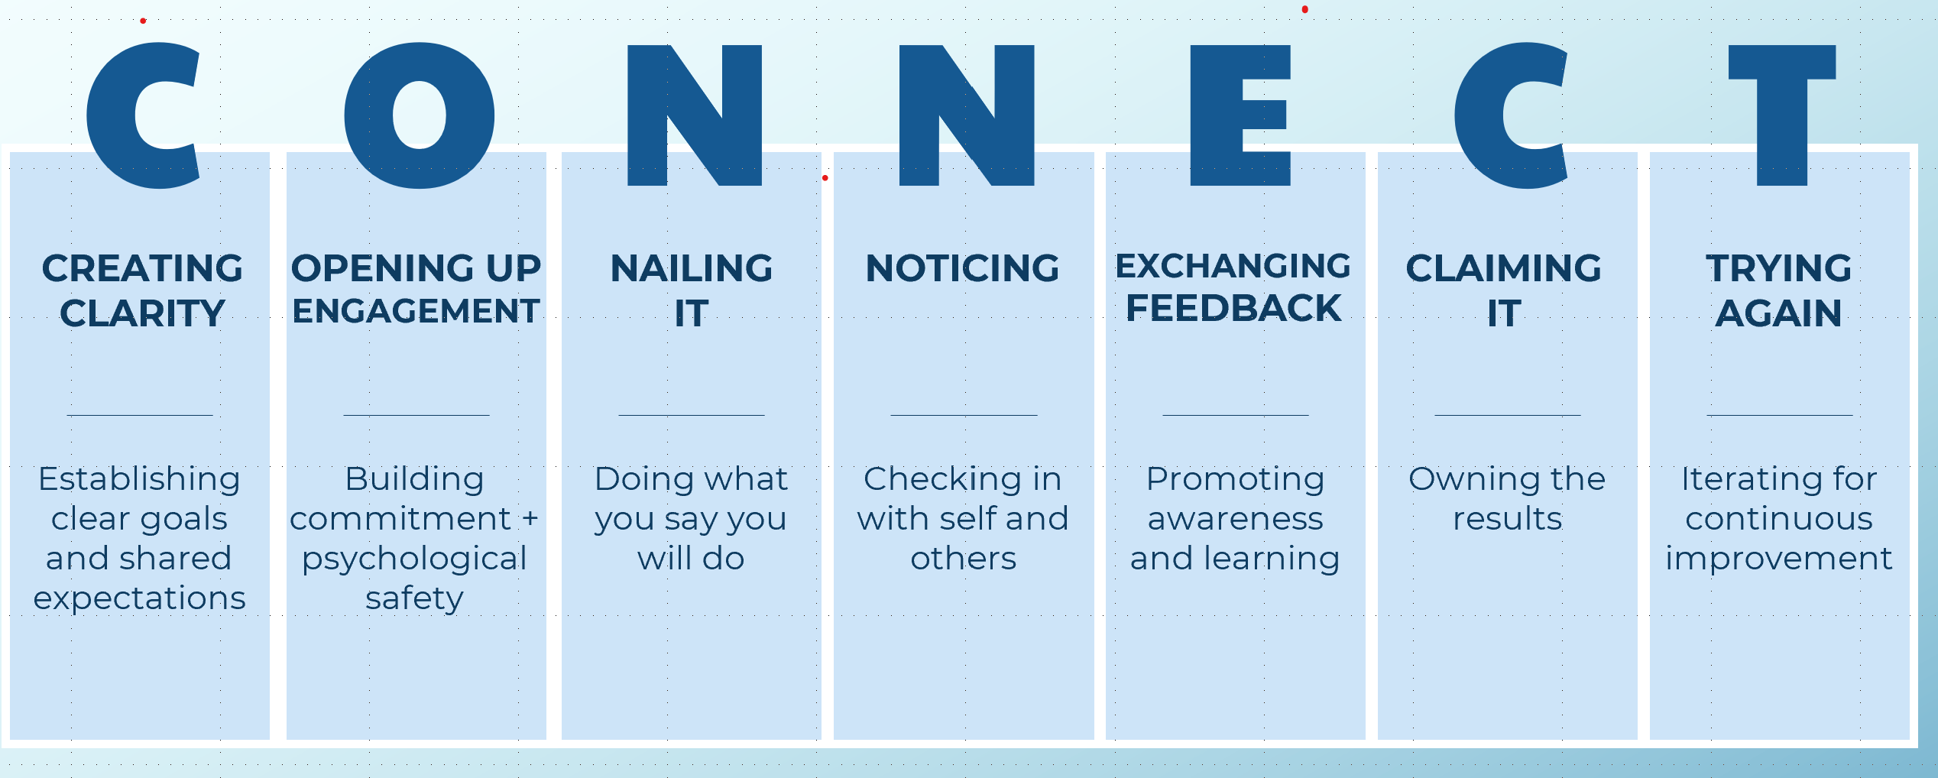
LET’S TAKE A POLL
I am really good at:
Practice 1
Practice 2
Practice 3
Practice 4
Practice 5
Practice 6
Practice 7
1
2
3
4
5
6
7

Slide 35
LET’S TAKE A POLL
I have the most room
for improvement in:
Practice 1
Practice 2
Practice 3
Practice 4
Practice 5
Practice 6
Practice 7
1
2
3
4
5
6
7

Slide 36
Linking Culture Development to Accountability:
Think of a change you are adapting to or want to make in your team, department, or in the larger organization.
Link each of the CONNECT practices to specific behaviors to create a more effective culture.
Individual reflection: Record ideas on the worksheet.
Small group conversation: share and compare ideas with peers
Large group synthesis: share themes with the full group.

Slide 37
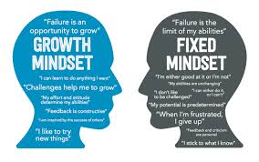
What is your Mindset?
Growth Mindset
People are capable of change
Continuum / relativity
Feedback is productive
Failure = learning opportunity, more likely to persist
Fixed mindset
People don’t really change
“You have it or you don’t”; Pass/Fail
Feedback is personal
Failure = exposes my flaws/defects, more likely to quit

Slide 38
ACTION PLANNING
List Stakeholder
What are the strengths? What is working well?
What needs to improve?
List action steps & dates of completion
How will I stay accountable to the plan?

Slide 39
QUESTIONS?
comments/reactions/feedback

Slide 40
THE CHALLENGE & THE INVITATION
Growth and the need for adaptation is here!
How can we build from here?
What would support you in building your capacity?
What would be some good next steps?

Slide 41

DON’T GO IT ALONE!
Please join our newly established Linked In group, where you can find fellow travelers, stay connected, and keep learning together.
https://www.linkedin.com/groups/12586735/

Slide 42


STAY IN TOUCH
david@tate-consulting.com
call/text: (203) 627-6618
LinkedIn: https://www.linkedin.com/in/david-tate-780683/

Slide 43
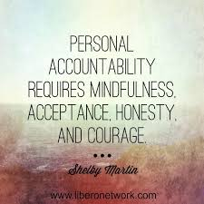
Closing Reflections
What was your #1 learning or insight?
What is one change you would like to consider making to improve your practice of accountability?

Slide 44

“Accountability is the measure of a leader’s height.” – Jeffrey Benjamin
“Accountability is the glue that ties commitment to the result” – Bob Proctor
“Holding your team accountable is not an exercise in control. It is an exercise in empowerment.”
–Anonymous

